Slide 1


CONCEPTUAL DESIGN REPORT FOR A LIGHT, MULTI-ROLE, FIREFIGHTING TURBOPROP AIRCRAFT
Bassi Andrea | 10665754
Bona Francesco | 10702485
Calabria Andrea | 10699474
Clementi Martina | 10680446
D’Agnese Luca | 10683614
Spinelli Luca | 10665724
Testa Laura | 10607107

Slide 2
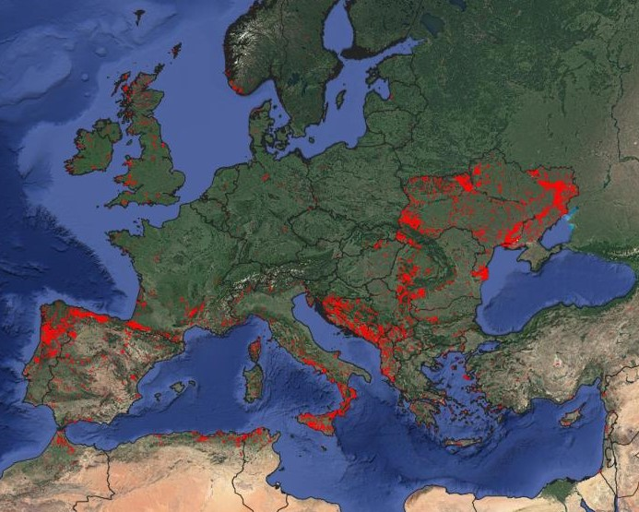

Problem: wildfires
“Recent hot, dry, summers have highlighted concerns regarding the ability to fight large wildfires, should they occur in the countryside or in forested or wooded areas, and particularly if they are in close proximity to residential buildings.”
RAeS RFP

Slide 3
Current European scenario
Fleet of aircfraft and helicopters dedicated to firefighting missions
RescEU project
Main players | Relevant problem
AT-802F | Slow, firefigthing only
Viking Air 415 | Outdated, limited in number
AgustaWestland AW139 | Expensive

Slide 4
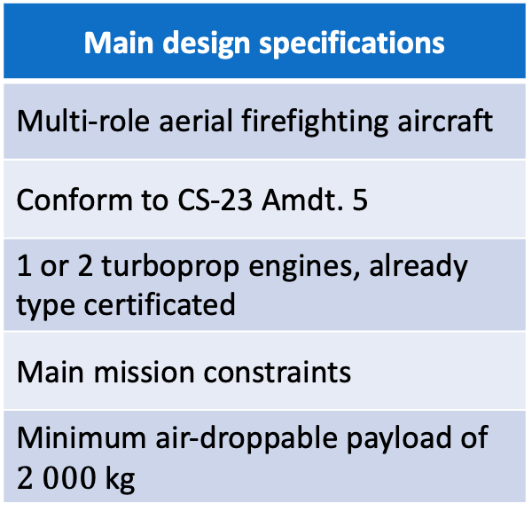
RAeS: Request for Proposal
Main design specifications
Multi-role aerial firefighting aircraft
Conform to CS-23 Amdt. 5
1 or 2 turboprop engines, already type certificated
Main mission constraints
Minimum air-droppable payload of $2 000$kg
Merit criteria
Fast cruise speed
Non-expensive aircraft
Trasportable payload

Slide 5
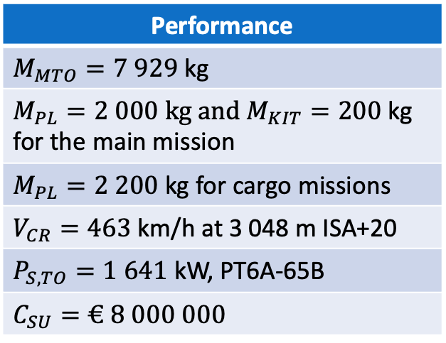
Solution
Main features
Twin turboprop
RAeS compliant
No pressurisation
VFR oriented
Secondary missions: surveillance, survey/charting, SAR and cargo
Performance
$M_{MTO}=7 929$ kg
$M_{PL}=2 000$ kg and $M_{KIT}=200$kg for the main mission
$M_{PL}=2 200$kg for cargo missions
$V_{CR}=463$km/h at 3 048 m ISA+20
$P_{S,TO}=1 641$ kW, PT6A-65B
$$C_{SU}=€ 8 000 000$$
Configuration
High-wing
Tractor, under wings propeller and engines
Retractable, tricycle landing gear
Cruciform tail

Slide 6
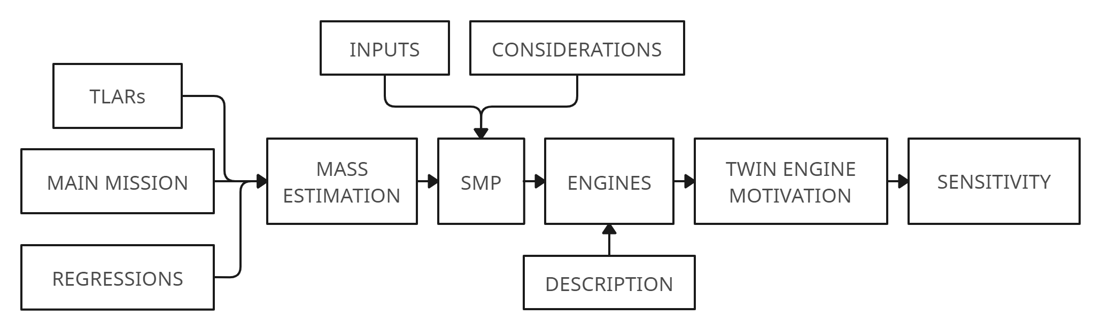
Sizing process: summary
Executed in parallel for single engine and twin engine design with minimal differences in the inputs
Notes:
This scheme is derived from Fig. 9.1, p. 66 (D), p. 74 (P)

Slide 7
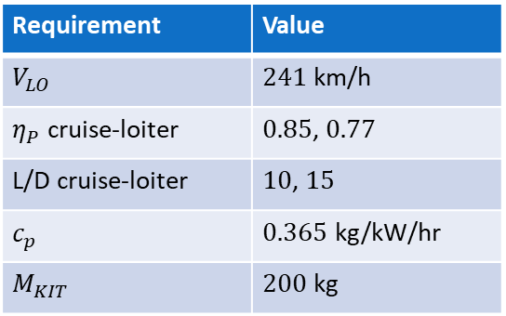
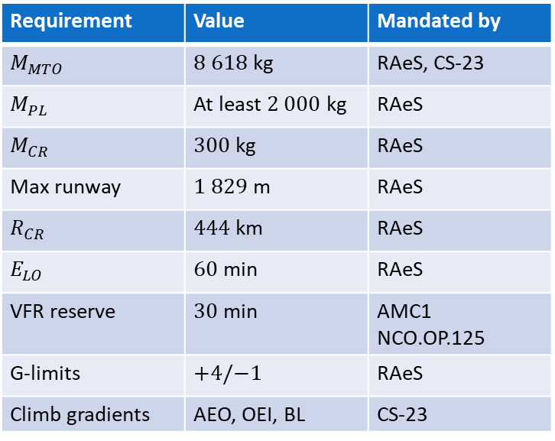
TLARs: mandated and chosen
Mandated by RAeS, CS-23 or other regulations
Chosen by the Team
Requirement | Value | Mandated by
$$M_{MTO}$$ | $8 618$kg | RAeS, CS-23
$$M_{PL}$$ | At least $2 000$kg | RAeS
$$M_{CR}$$ | $300$ kg | RAeS
Max runway | $1 829$m | RAeS
$$R_{CR}$$ | $444$ km | RAeS
$$E_{LO}$$ | $60$ min | RAeS
VFR reserve | $30$ min | AMC1 NCO.OP.125
G-limits | $$+4/−1$$ | RAeS
Climb gradients | AEO, OEI, BL | CS-23
Requirement | Value
$$V_{LO}$$ | $241$ km/h
$η_{P}$ cruise-loiter | $0.85$, $0.77$
L/D cruise-loiter | $10$, $15$
$$c_{p}$$ | $0.365$ kg/kW/hr
$$M_{KIT}$$ | $200$ kg
Notes:
Tab. 9.1, p. 80 (D), p.88 (P) Tab. 9.2, 9.3, 9.4, p. 81-82(D), p.89-90 (P)
Fino a Elo elencare
VFR citare
Altri due da citare
Spiegare quelli a dx
Etap da roskam
L/D deciso
SFC da motori
KIT da rivenditore

Slide 8
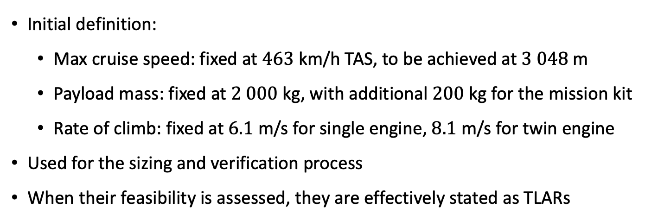
TLARs: particular cases
Initial definition:
Max cruise speed: fixed at $463$ km/h TAS, to be achieved at $3 048$m
Payload mass: fixed at $2 000$kg, with additional $200$ kg for the mission kit
Rate of climb: fixed at $6.1$ m/s for single engine, $8.1$ m/s for twin engine
Used for the sizing and verification process
When their feasibility is assessed, they are effectively stated as TLARs
Notes:
Cruise: più alta, entro limite vfr
Payload: evitare di gravare ulteriormente, margine
ROC scelto in base ai competitors

Slide 9
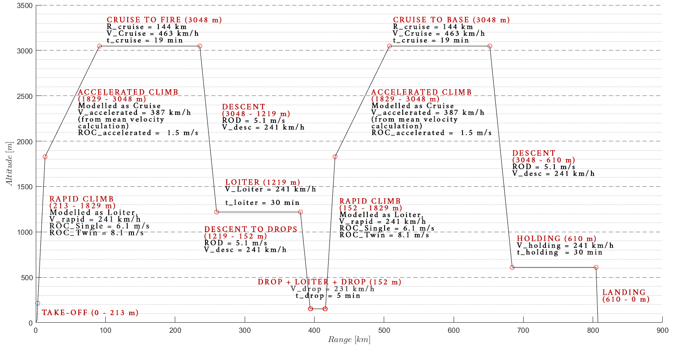
Main mission
Notes:
decollo, salita iniziale rapida, salita accelerata, cruise, prima discesa, loiter, discesa. Dopo un primo lancio di metà del payload, l’aereo svolge una manovra di allontanamento, virata e avvicinamento a 152 m di altezza, limite inferiore per il VFR, seguita dal secondo lancio. La missione poi viene ripetuta analogamente a prima.
Derived from Fig. 12.2, p.123 (D)

Slide 10
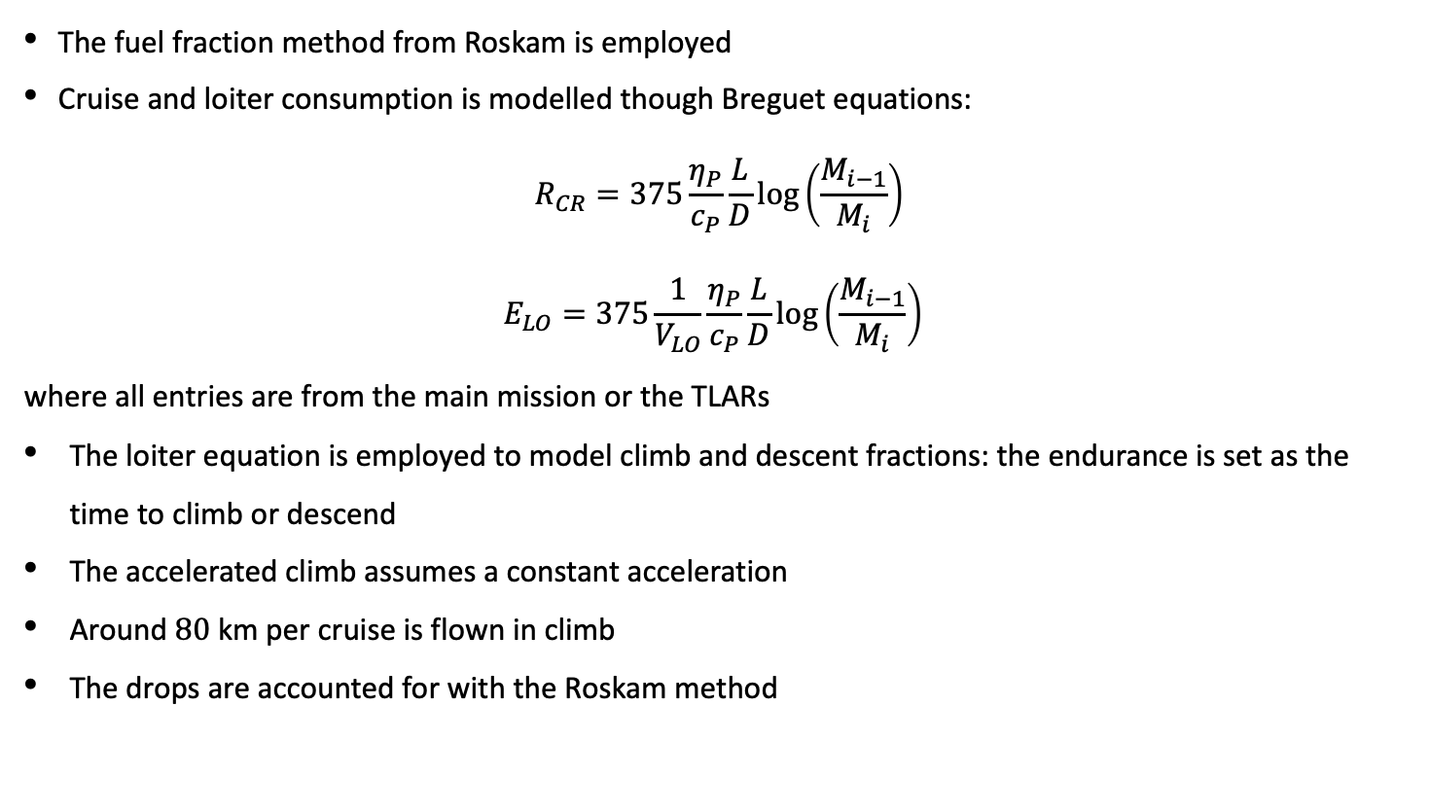
Main mission: modelling
The fuel fraction method from Roskam is employed
Cruise and loiter consumption is modelled though Breguet equations:
$$R_{CR}=375\frac{η_{P}}{c_{P}}\frac{L}{D}log⁡\left(\frac{M_{i−1}}{M_{i}}\right)$$
$$E_{LO}=375\frac{1}{V_{LO}}\frac{η_{P}}{c_{P}}\frac{L}{D}log\left(\frac{M_{i−1}}{M_{i}}\right)⁡$$
where all entries are from the main mission or the TLARs
The loiter equation is employed to model climb and descent fractions: the endurance is set as the time to climb or descend
The accelerated climb assumes a constant acceleration
Around $80$ km per cruise is flown in climb
The drops are accounted for with the Roskam method

Slide 11
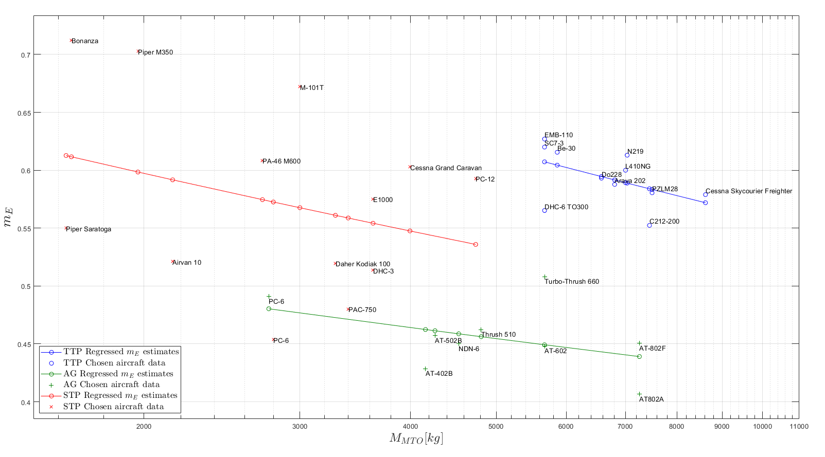
Regression

Slide 12
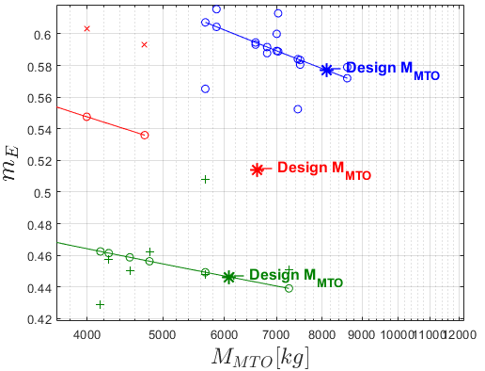
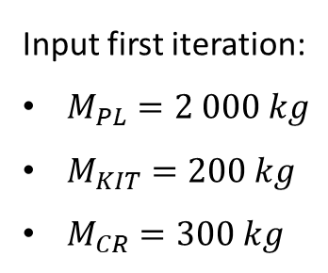
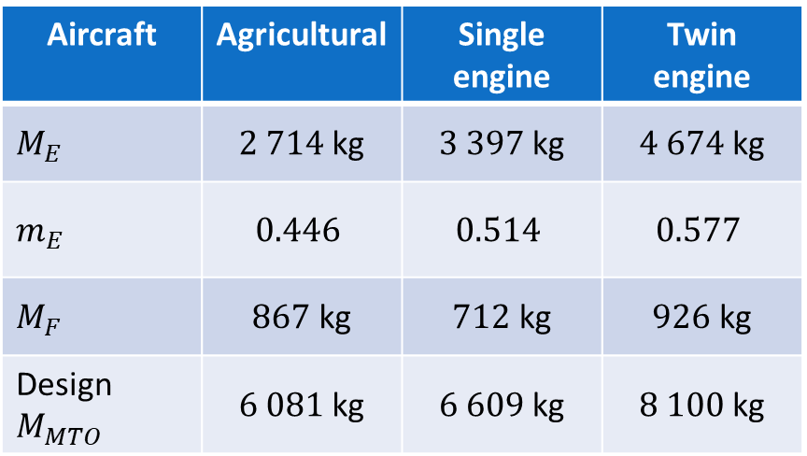
First mass estimation: results
Input first iteration:
$M_{PL}=2 000 kg$
$M_{KIT}=200 kg$
$M_{CR}=300 kg$
Aircraft | Agricultural | Single engine | Twin engine
$$M_{E}$$ | $2 714$kg | $3 397$kg | $4 674$kg
$$m_{E}$$ | $$0.446$$ | $$0.514$$ | $$0.577$$
$$M_{F}$$ | $867$ kg | $712$ kg | $926$ kg
Design $M_{MTO}$ | $6 081$kg | $6 609$kg | $8 100$kg

Slide 13
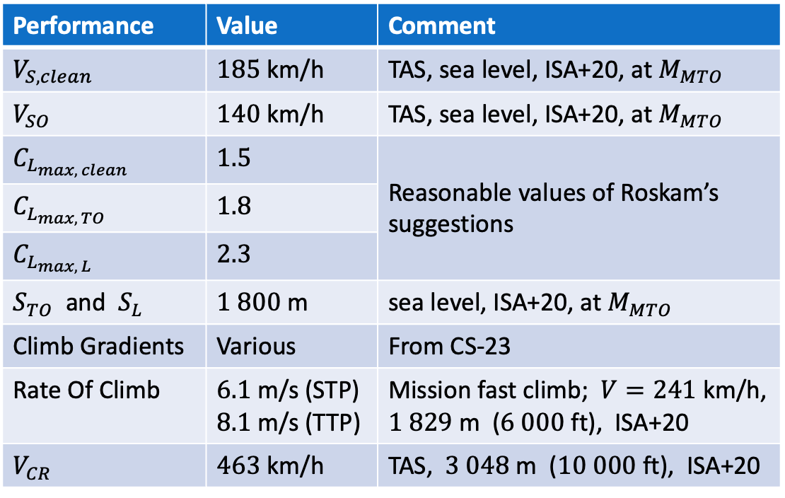
Sizing Matrix Plot: input description
Performance | Value | Comment
$$V_{S,clean}$$ | $185$ km/h | TAS, sea level, ISA+20, at $M_{MTO}$
$$V_{SO}$$ | $140$ km/h | TAS, sea level, ISA+20, at $M_{MTO}$
$$C_{L_{max, clean}}$$ | $$1.5$$ | Reasonable values of Roskam’s suggestions
$$C_{L_{max, TO}}$$ | $$1.8$$
$$C_{L_{max, L}}$$ | $$2.3$$
$S_{TO}$ and $S_{L}$ | $1 800$m | sea level, ISA+20, at $M_{MTO}$
Climb Gradients | Various | From CS-23
Rate Of Climb | $6.1$ m/s (STP) $8.1$ m/s (TTP) | Mission fast climb; $V=241$km/h, $1 829$m ($6 000$ft), ISA+20
$$V_{CR}$$ | $463$ km/h | TAS, $3 048$m ($10 000$ft), ISA+20
Sizing factor for:
STP
TTP
MC Power 80 %
Cruise Power
Fast Climb Power

Slide 14
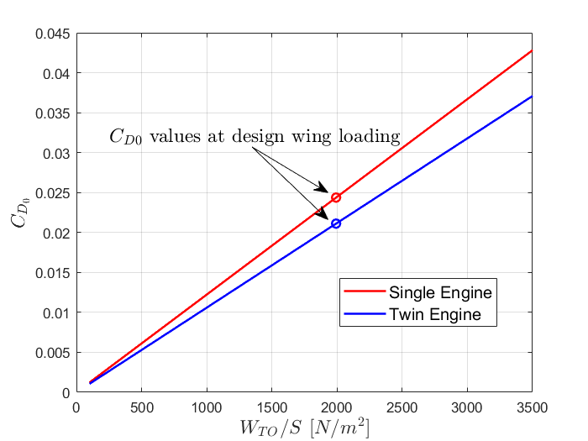
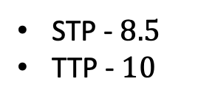
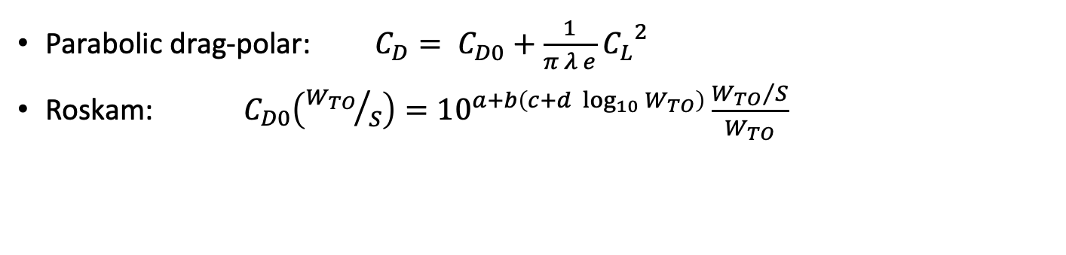
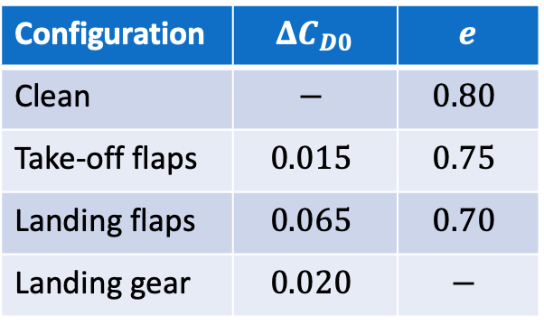
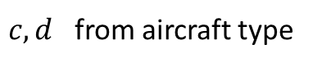
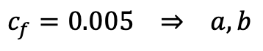
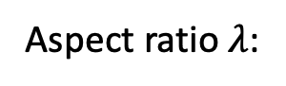
Sizing Matrix Plot: polar approximation
Parabolic drag-polar: $C_{D}= C_{D0}+\frac{1}{π λ e}$ ${C_{L}}^{2}$
Roskam: $C_{D0}\left({W_{TO}}/S\right)={10}^{a+b\left(c+d \log_{10}{W_{TO}}\right)}\frac{{W_{TO}}/S}{W_{TO}}$
$$c_{f}=0.005 ⇒ a,b$$
$c,d$ from aircraft type
Configuration | $$ΔC_{D0}$$ | $$e$$
Clean | $$−$$ | $$0.80$$
Take-off flaps | $$0.015$$ | $$0.75$$
Landing flaps | $$0.065$$ | $$0.70$$
Landing gear | $$0.020$$ | $$−$$
STP - $8.5$
TTP - $10$
Aspect ratio $λ$:

Slide 15
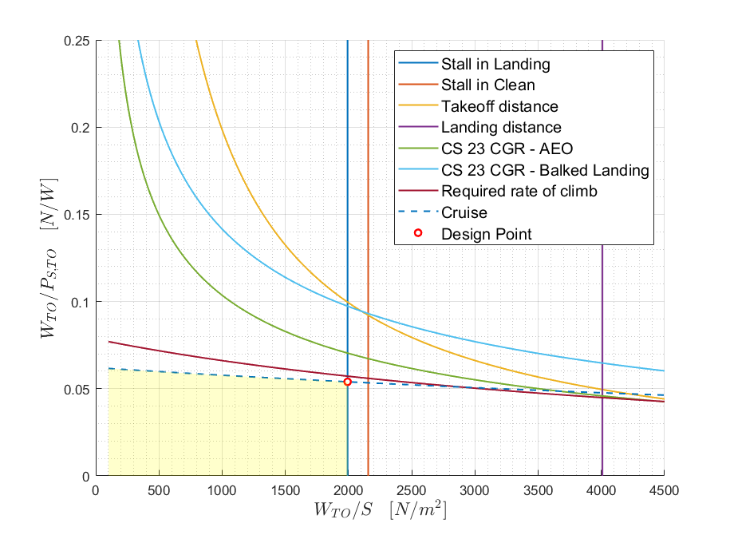
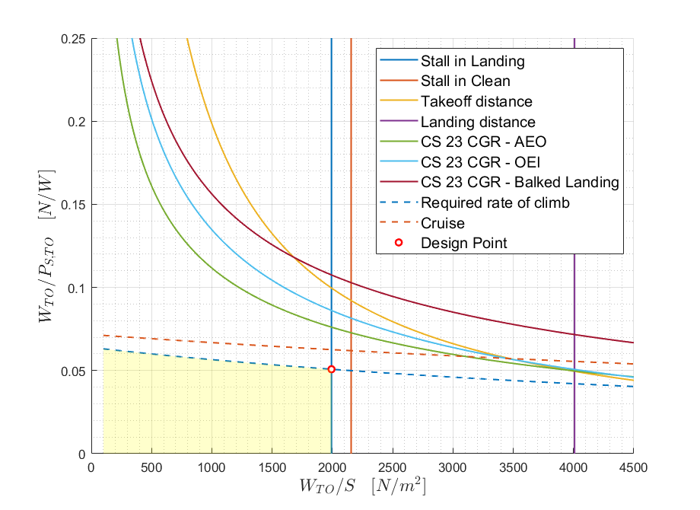
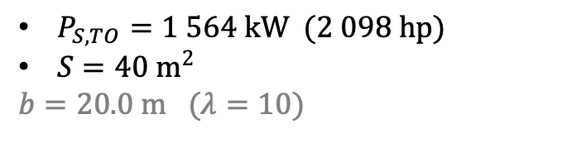
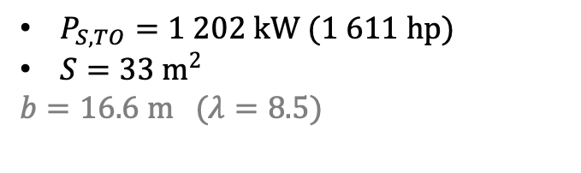
Sizing Matrix Plot: results
Single engine aircraft
Twin engine aircraft
$P_{S,TO}=1 202 kW (1 611 hp)$
$S=33 m^{2}$
$$b=16.6 m (λ=8.5)$$
$P_{S,TO}=1 564 kW (2 098 hp)$
$S=40 m^{2}$
$$b=20.0 m (λ=10)$$

Slide 16
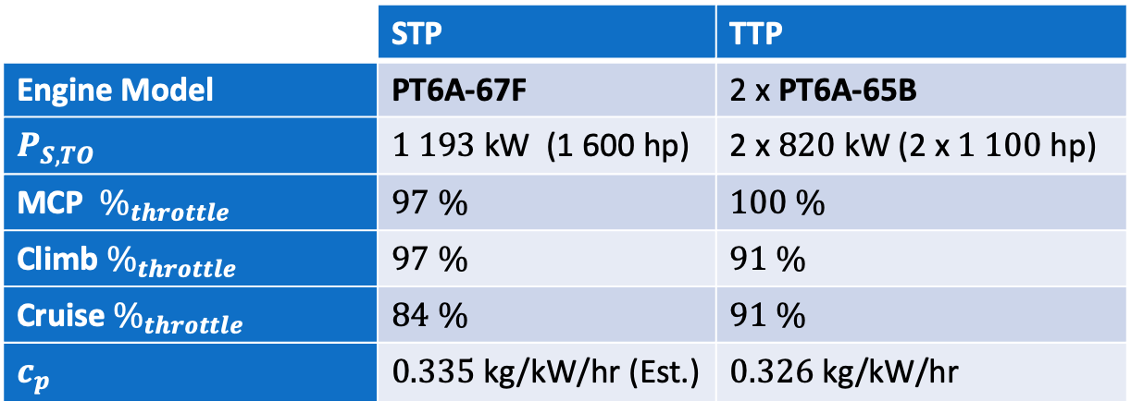
Engine selection
“… the turboprop engine type chosen must be one that is already type certificated, with the type certificate recognized by the UK CAA, and still in production.”
RAeS RFP
Both selected engines belong to the PT6A-60 family by Pratt & Whitney Canada.
 | STP | TTP
Engine Model | PT6A-67F | 2 x PT6A-65B
$P_{S,TO}$ | $1 193$kW (1 600 hp) | 2 x $820$ kW (2 x $1 100$hp)
MCP $\%_{throttle}$ | $$97 \%$$ | $$100 \%$$
Climb $\%_{throttle}$ | $$97 \%$$ | $$91 \%$$
Cruise $\%_{throttle}$ | $$84 \%$$ | $$91 \%$$
$c_{p}$ | $0.335$ kg/kW/hr (Est.) | $0.326$ kg/kW/hr

Slide 17
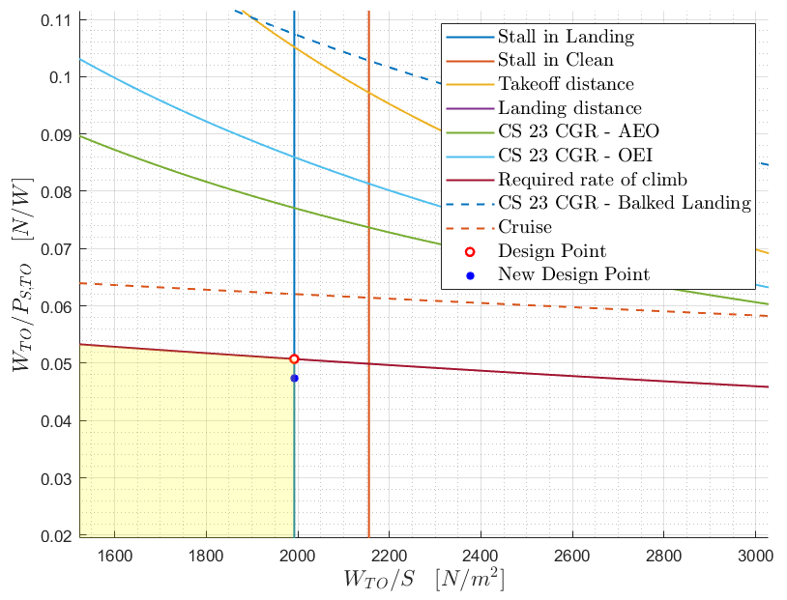
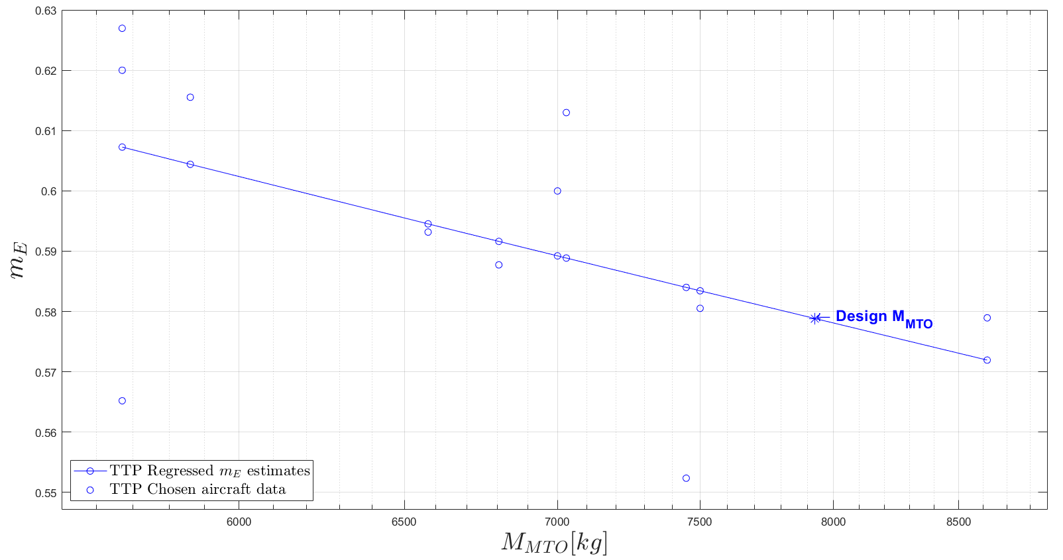
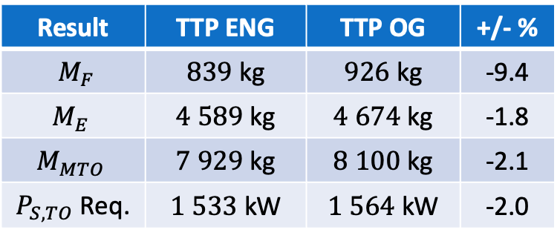
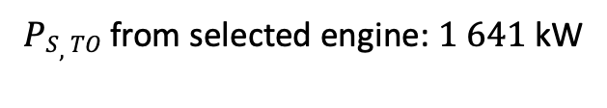
TTP sizing results with selected engine
Result | TTP ENG | TTP OG | +/- %
$M_{F}$ | $839$ kg | $926$ kg | -9.4
$$M_{E}$$ | $4 589$kg | $4 674$kg | -1.8
$$M_{MTO}$$ | $7 929$kg | $8 100$kg | -2.1
$P_{S,TO}$ Req. | $1 533$kW | $1 564$kW | -2.0
$PS,TO$from selected engine: $1 641$kW

Slide 18
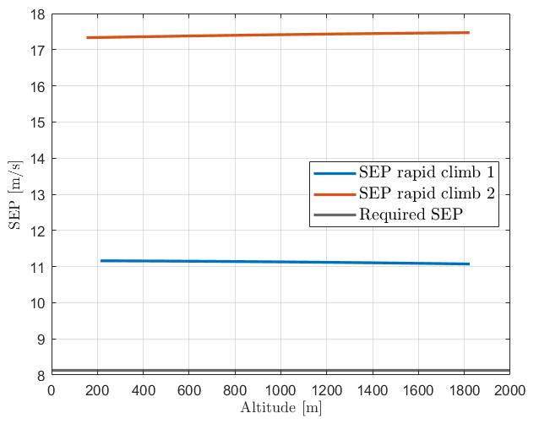
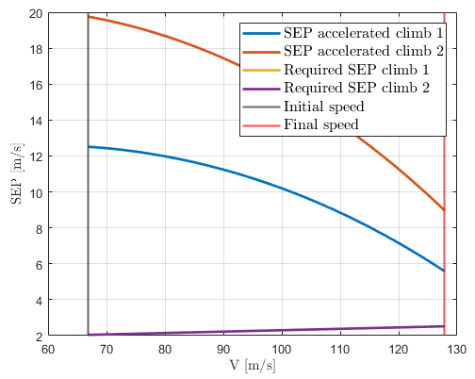
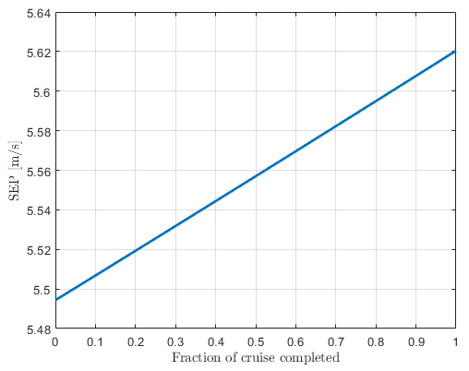
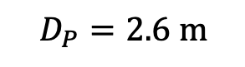
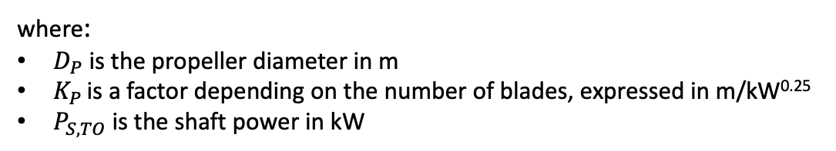
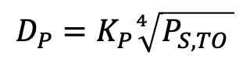
SEP results and propeller diameter
SEP results
Propeller diameter
where:
$D_{P}$ is the propeller diameter in m
$K_{P }$is a factor depending on the number of blades, expressed in m/kW^{0.25}
$P_{S,TO}$ is the shaft power in kW
$$D_{P}=K_{P}\sqrt[4]{P_{S,TO }}$$
$$D_{P}=2.6 m$$

Slide 19
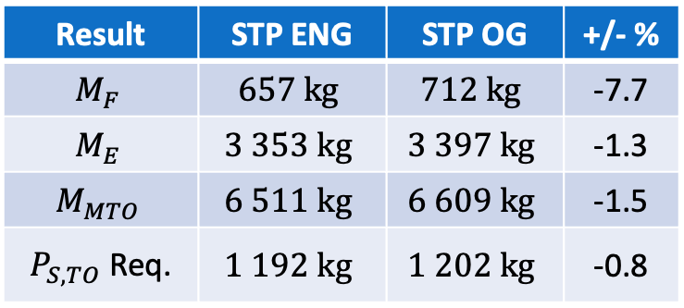
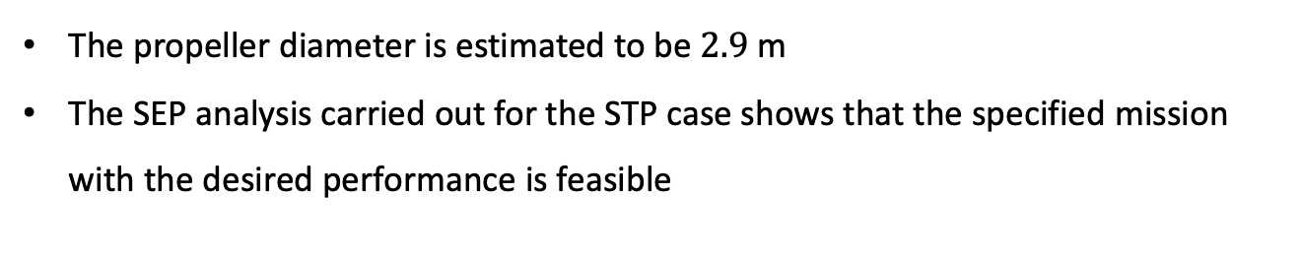
STP sizing results with selected engine
Result | STP ENG | STP OG | +/- %
$$M_{F}$$ | $$657 kg$$ | $$712 kg$$ | -7.7
$$M_{E}$$ | $$3 353 kg$$ | $$3 397 kg$$ | -1.3
$$M_{MTO}$$ | $$6 511 kg$$ | $$6 609 kg$$ | -1.5
$P_{S,TO}$ Req. | $$1 192 kg$$ | $$1 202 kg$$ | -0.8
The propeller diameter is estimated to be $2.9$ m
The SEP analysis carried out for the STP case shows that the specified mission with the desired performance is feasible

Slide 20
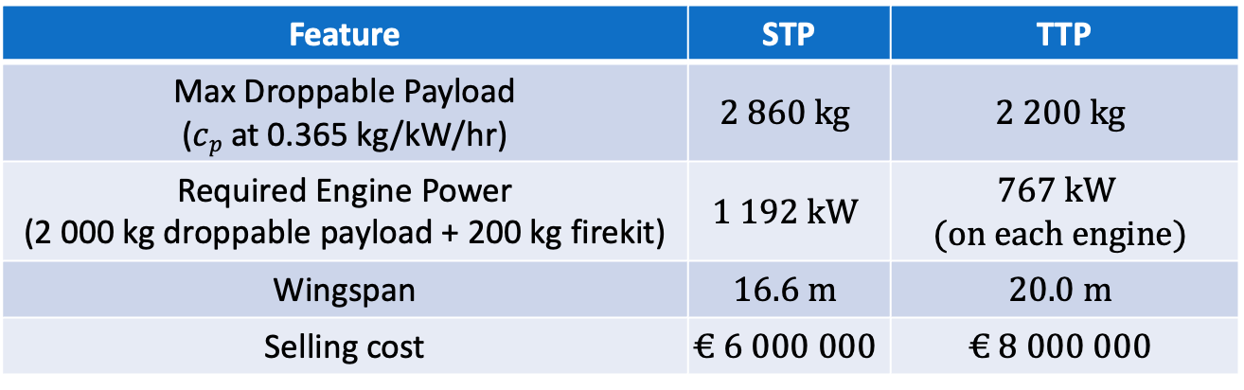
Twin Engine selection justification
Feature | STP | TTP
Max Droppable Payload ($cp$ at 0.365 kg/kW/hr) | $$2 860 kg$$ | $$2 200 kg$$
Required Engine Power (2 000 kg droppable payload + 200 kg firekit) | $$1 192 kW$$ | $$767 kW$$ $$(on each engine)$$
Wingspan | $$16.6 m$$ | $$20.0 m$$
Selling cost | $$€ 6 000 000$$ | $$€ 8 000 000$$
By having two engines, SAFETY IS GREATLY INCREASED. The presence of an extra engine is a life-saver in the most dangerous mission phases.

Slide 21
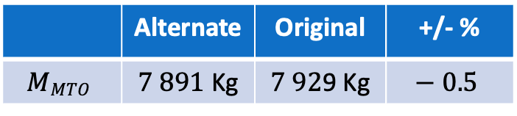
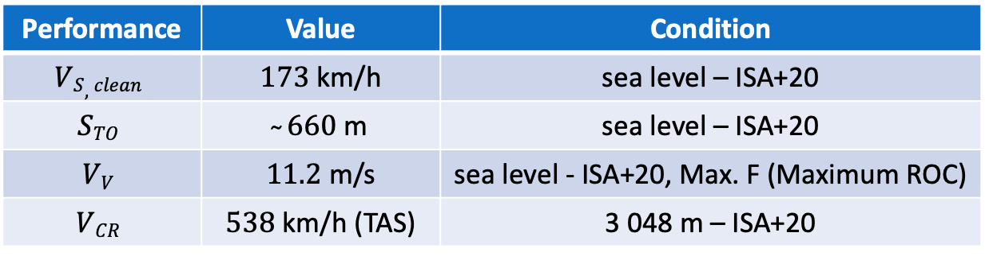
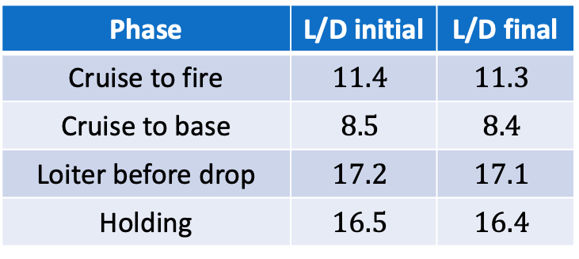
Final TTP results
Performance | Value | Condition
$$VS,clean$$ | $173$ km/h | sea level – ISA+20
$$STO$$ | $̴ 660$m | sea level – ISA+20
$$VV$$ | $11.2$ m/s | sea level - ISA+20, Max. F (Maximum ROC)
$$VCR$$ | $538$ km/h (TAS) | 3 048 m – ISA+20
Computed L/D ratios:
Alternate mass estimate results:
Phase | L/D initial | L/D final
Cruise to fire | $$11.4$$ | $$11.3$$
Cruise to base | $$8.5$$ | $$8.4$$
Loiter before drop | $$17.2$$ | $$17.1$$
Holding | $$16.5$$ | $$16.4$$
 | Alternate | Original | +/- %
$$MMTO$$ | $7 891$Kg | $7 92$9 Kg | $$− 0.5$$

Slide 22
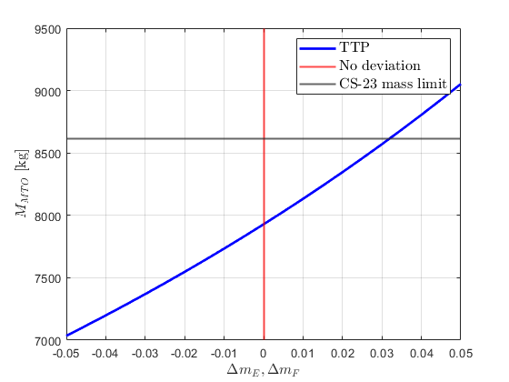
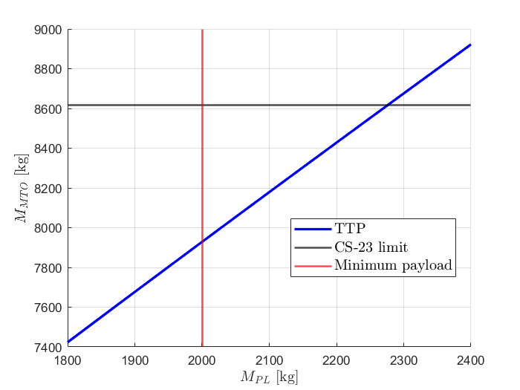
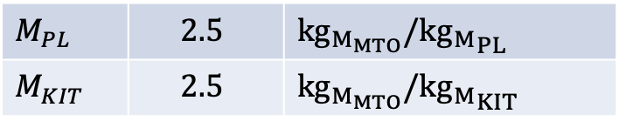
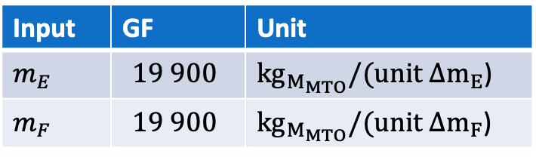
Sensitivity: $m_{E}$, $m_{F}$, $M_{PL}$, $M_{K}$
Input | GF | Unit
$$m_{E}$$ | $$19 900$$ | ${kg}_{M_{MTO}}/(unit{ Δm}_{E}$)
$$m_{F}$$ | $$19 900$$ | ${kg}_{M_{MTO}}/(unit {Δm}_{F}$)
Input | GF | Unit
$$M_{PL}$$ | $$2.5$$ | $${kg}_{M_{MTO}}/{{kg}_{M}}_{PL}$$
$$M_{KIT}$$ | $$2.5$$ | $${kg}_{M_{MTO}}/{{kg}_{M}}_{KIT}$$

Slide 23
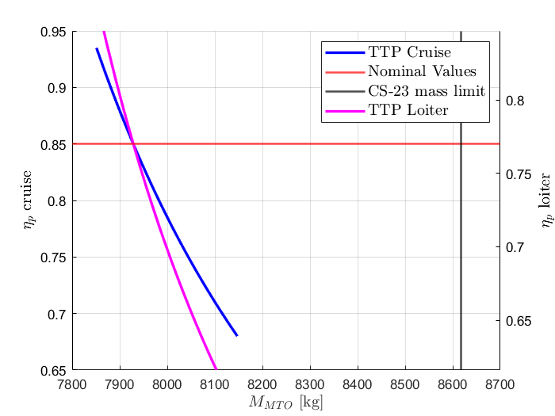
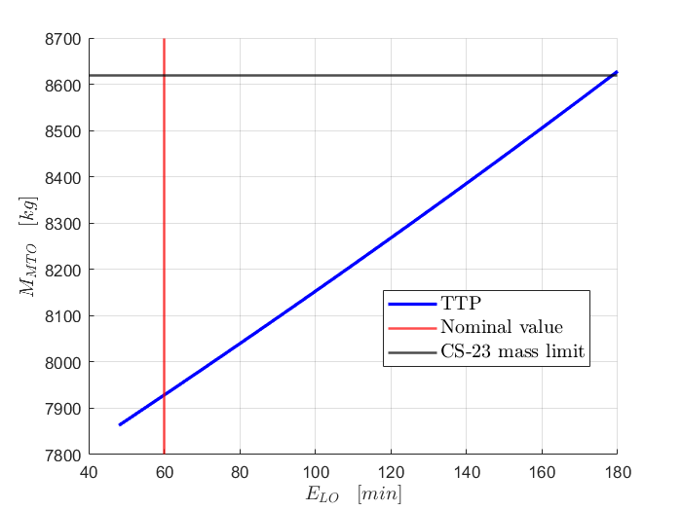
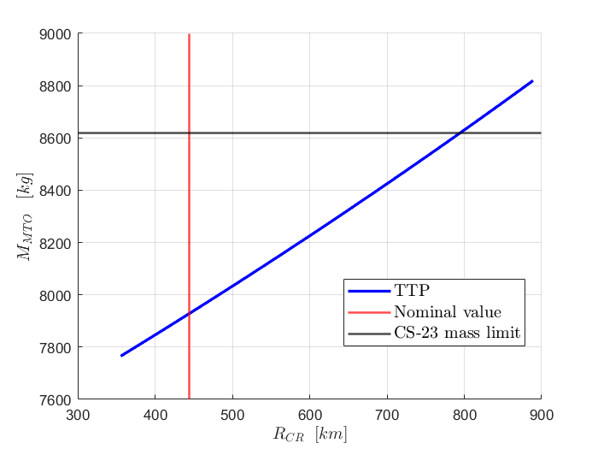
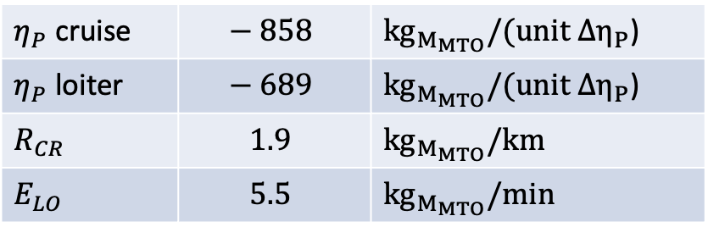
Sensitivity: $η_{P}$, $R_{CR}$, $E_{Lo}$
Input | GF | Unit
$η_{P}$ cruise | $$− 858$$ | ${kg}_{M_{MTO}}/(unit {∆η}_{P}$)
$η_{P}$ loiter | $$− 689$$ | ${kg}_{M_{MTO}}/(unit{ ∆η}_{P}$)
$$R_{CR}$$ | $$1.9$$ | $${kg}_{M_{MTO}}/km$$
$$E_{LO}$$ | $$5.5$$ | $${kg}_{M_{MTO}}/min$$

Slide 24



SMP Sensitivity: $c_{f}$, $V_{SO}$, $V_{CR}$

Slide 25


Secondary missions
Surveillance
Survey and Charting
Search and Rescue

Slide 26


Secondary missions
Cargo

Slide 27



Cost analysis: Gudmundsson approach
Eastlake model: input data
Economic variables:
Aircraft key parameters:
Different factors related to:
- Experience effectiveness: $F_{EXP}$
- Certification: $F_{CERT}$
- Flaps: $F_{FLAPS}$
- Composite materials: $F_{COMP}$
- Pressurisation: $F_{PRESS}$
assume different values depending on the specific characteristics of the aircraft
$$R_{ENG}$$ | $$130 €/h$$
$$R_{TLG}$$ | $$90 €/h$$
$$R_{MFG}$$ | $$80 €/h$$
$$N_{U}$$ | $$150$$
$$N_{P}$$ | $$4$$
$$M_{A}$$ | $2 983$kg
$$V_{CR}$$ | $463$ km/h
$$P_{S,TO}$$ | $1 641$kW
$$D_{P}$$ | $2.6$ m
Also:
- CPI
- Dollar-to-Euro conversion

Slide 28




Cost analysis: results
Output data:
Category | Hours
Engineering | $536 000$hr
Tooling | $345 000$hr
Manufacturing | $1 852 000$hr
Category | COST (per unit)
Engineering | € $1 296 000$
Tooling | € $578 000$
Manufacturing | € $2 755 000$
Development + Flight test + quality control + materials + avionics + landing gear | € $605 000$
Engine + Propeller | € $1 090 000$
TOTAL COST PER UNIT | € $5 558 000$

Slide 29
Configuration selection
Features analysed:
High-wing
Wings
Mid-wing
High-wing
Low-wing
Engines and propellers
Tractor, under wings
Landing gear
Retractable, tricycle
Conventional
Horizontal and vertical tail
Cruciform
To be studied…
T-tail
H-tail

Slide 30

Configuration selection: results
Features | Weight | Conventional | Cruciform | T-tail | H-tail
OEI governability | $$3$$ | $$1$$ | $$1$$ | $$1$$ | $$3$$
Does the design look ‘conventional’? | $$1$$ | $$3$$ | $$3$$ | $$2$$ | $$1$$
Spin recovery | $$2$$ | $$1$$ | $$2$$ | $$3$$ | $$2.5$$
….. | ….. | ….. | ….. | ….. | …..
Results | $$52.5$$ | $$53$$ | $$50.5$$ | $$50$$
Wing | High-wing
Engine & propellers | Tractor, under wing
Landing gear | Retractable, tricycle
Tail configuration | Cruciform
Winning configuration:

Slide 31
Open issues
Mass limit
Aerodynamic performance
Landing gear
Propeller
Operating cost
Additional considerations:
Mission equipment
Night-time firefighting

